Slide 1
Adding Structure to Top-K: Form Items to Expansions
Date : 2012.5.21
Source : CIKM’ 11
Speaker : I-Chih Chiu
Advisor : Dr. Jia-Ling Koh

Slide 2
Index
Introduction
Problem Definition
Basic Algorithm
Semantic Optimization
Experiments
Conclusion

Slide 3
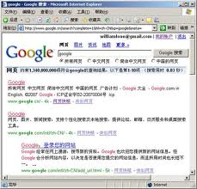
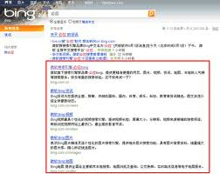
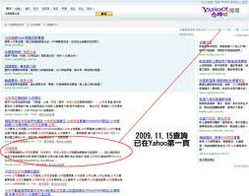
Introduction
Keyword based search interfaces are extremely popular.
Notes:
舉例 今天天氣如何 whats the weather today
重點在於”語意”

Slide 4
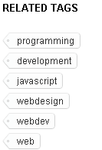
Introduction
Google search
Query → What’s the weather today?
Results include ‘what’, ’weather’, ’today’.
Lack of semantic.
Del.icio.us
Search results → Using a faceted interface.
Expansions → A fixed set of tags.
Notes:
像拍賣網站 商品資訊 價格 運費 地區

Slide 5
Introduction
Motivated by these drawbacks of current search result interfaces, considering a search scenario in which each item is annotated with a set of keywords.
Don’t need to assume the existence of pre-defined categorical hierarchy
Want to automatically group query result items into different expansions of the query corresponding to subsets of keywords.

Slide 6
Index
Introduction
Problem Definition
Basic Algorithm
Semantic Optimization
Experiments
Conclusion

Slide 7
Problem Definition
A set of items S = {t₁, ..., t_{n}}
A set of m attributes {a₁, ..., a_{m}}
The overall utility of an item t_{i}, $u\left(ti\right)=\sum_{j∈1…m}{wj∗ti.aj}$
Given a query Q
t_{i}.a_{j} : normalized
to [0,1]
 | Author(0.3) | Click(0.6)
t1 | 0.6 | 0.8
t2 | 0.7 | 0.2
t3 | 0.4 | 0.3
t4 | 0.9 | 0.4
u(t_{i})
0.6*0.3+0.6*0.8=0.64
0.3*0.7+0.6*0.2=0.33
0.3*0.4+0.6*0.3=0.30
0.3*0.9+0.6*0.4=0.51
Notes:
the number of items matching a query Q can often be huge, and merely returning the top-n
matching items may not help the user find the items they are most interested in.

Slide 8
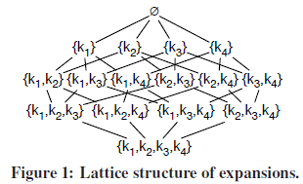
Problem Definition
Group items into different expansions of Q and return high quality expansions.
A subset of keywords e ⊆ K − Q. (K : all keywords)
Subset-of relationship for K-Q={k₁,k₂,k₃,k₄}
Notes:
除了query以外的keywords還能夠提供哪些資訊
利用lattice structure呈現出所有可能組合的keywords

Slide 9
Determining Importance of An Expansion
Definition : Top-k Expansions.
Given a set S of items and a keyword query Q, find the top-k expansion set E_{k} = {e₁, ..., e_{k}} s.t. ∀e ∈ E_{k} and ∀e′ ∈ E_{Q} − E_{k} , u(e) ≥ u(e′).
Only consider top-N matching items
V_{Se} = {u(t) | t ∈ S_{e}}
$g\left(Se\right)≔\sum_{v∈topN(VSe)}{v}$
If S_{e1} ⊆ S_{e2} ,
then g(S_{e1}) ≤ g(S_{e2}).
 | S_{k1} | S_{k1,k2} | S_{k2,k3}
t₁(k₁) | 0.4 | X | X
t₂(k₁,k₂) | 0.6 | 0.5 | X
t₃(k₃) | X | X | 0.6
g(S_{e}) | 1.0 | 0.5 | 0.6

Slide 10
Index
Introduction
Problem Definition
Basic Algorithm
Semantic Optimization
Experiments
Conclusion

Slide 11
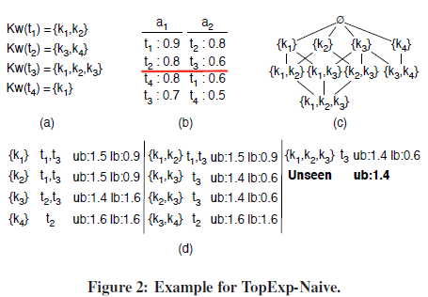
Naïve Algorithm
Round-robin
TopExp-Naïve algorithm
Access items in the non-increasing order of their attribute value
For each matching item accessed, enumerate all possible expansions and update their lower bound and upper bound utility value;
Stop the iterative process once top-k expansions have been identified and $lb≥ub$.
Stop the iterative process once top-k expansions have been identified and 𝑙𝑏≥𝑢𝑏.
Notes:
Round-robin

Slide 12
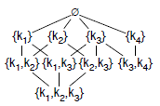
Improved Algorithm
Drawback of the naïve algorithm
2^{|Kw(t)−Q|} possible expansions
Leverage the lattice structure of expansions to avoid enumerating and maintaining unnecessary expansions.
∀k ∈ K_{<t}, k $∉$ e_{t} , we just need to maintain one single expansion e_{t}.
L
L_{K}

Slide 13
Improved Algorithm
Avoiding Unnecessary Expansions
If ∀e ∈ L , e ∩ e_{t} $=$ ∅
If ∃e ∈ L , e ∩ e_{t} $≠$ ∅
e $⊆$ e_{t}
e_{t} $⊆$ e
e $⊈$ e_{t} or e_{t} $⊈$ e

Slide 14
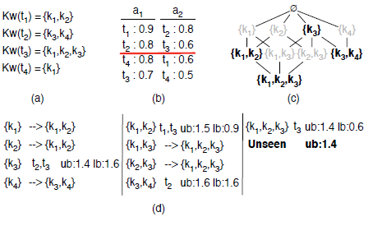
Improved Algorithm
TopExp-Lazy algorithm
Access items in the non-increasing order of their attribute value
If ∀e ∈ L , e ∩ e_{t} $=$ ∅
Else If ∃e ∈ L , e ∩ e_{t} $≠$ ∅
(1)e $⊆$ e_{t}
(2)e_{t} $⊆$ e
(3) e $⊈$ e_{t} or e_{t} $⊈$ e
update their lower bound and upper bound utility value
If ∀e ∈ L , e ∩ e_{t} = ∅
Else If ∃e ∈ L , e ∩ e_{t} ≠ ∅
(1)e ⊆ e_{t}
(2)e_{t} ⊆ e
(3) e ⊈ e_{t} or e_{t} ⊈ e
update their lower bound and upper bound utility value
Stop the iterative process once top-k expansions have been identified and $lb≥ub$.
Stop the iterative process once top-k expansions have been identified and 𝑙𝑏≥𝑢𝑏.

Slide 15
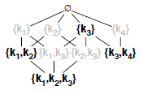
Improved Algorithm
To count how many expansions correspond to the same set of items.
Use the classical inclusion-exclusion principle.
2^{|e|} − count − 1
count += 2^{|e’|}-1
E.g. e = {k₁,k₂,k₃} → 8 (2^{|e|})
e’ = {k₁,k₂},{k₃} → 4 (count)
8 – 4 – 1 = 3
({k₁, k₂, k₃}, {k₁, k₃} and {k₂, k₃}).

Slide 16
Index
Introduction
Problem Definition
Basic Algorithm
Semantic Optimization
Experiments
Conclusion
Notes:
Though algorithms described in Section 3 can correctly find expansions which have the k highest utility, there are two kinds of issues with these algorithms.
First, the basic algorithm will favor small expansions (i.e., fewer keywords) as these expansions have more matching items than larger expansions.
Second, in the returned top-k expansions, it may happen that two expansions have the subset-of relationship, which is not ideal.

Slide 17
Weighting Expansions
Small size (e.g., “XML”) → “general topics”
Large size (e.g., “XML, schema, conformance, automata”) → “specific topics”
Expansions are neither too large nor too small.
consider the Gaussian function $fw\left(p\right)=e^{−\frac{\left(x−μ\right)2}{2σ2}}$
{K₁,k₂} → u(e)× f_{w}(2) and (e)× f_{w}(2)
{k₁},{k₂} → u(e)× f_{w}(1) and (e)× f_{w}(1)

Slide 18
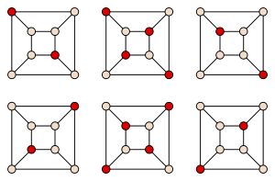
Path Exclusion based Algorithm
Definition (Maximum k Path-Exclusive Expansion)
Given a set S of items and a keyword query Q, find the top k-expansion set E_{k} = {e₁, ..., e_{k}} s.t. ∀e_{i} , e_{j} ∈ E_{k} , i $≠$ j, e_{i} $⊄$ e_{j}, e_{j} $⊄$ e_{i}, and $\sum_{e∈EK}{u(e)}$is maximized.
The maximum k path-exclusive expansion problem is NP-hard by a direct reduction from the maximum weighted independent set problem.

Slide 19
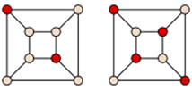
Path Exclusion based Algorithm
$max⁡(δw, 1)−$approximation
$δw=\max{H⊆G }\min{v∈V(H)}dw\left(v,H\right)$ , $dw\left(v,H\right)=\frac{w(NG(v))}{w(\{v\})}$
w(S) is the sum of weights of a set of nodes S
N_{G}(v) is the set of neighbors of v in G.
G
Assume weights are equal 1.
H₁
H₂
$$dw\left(v,H1\right)=\frac{12}{2}=6$$
$$dw\left(v,H2\right)=\frac{12}{4}=3$$

Slide 20
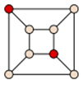
Path Exclusion based Algorithm
Top-PEkExp algorithm
Generate necessary expansions using TopExp-Lazy
R^{G} ←GreedyMWIS(L);
E_{topk} ←k expansions in L which have the largest upper bound utilities;
U∗ = sum_{e∈Etopk} (e);
Stop the iterative process once $u\left(RG\right)≥\frac{1}{α}×U∗$.
U∗ = sum_{e∈Etopk} (e);
Stop the iterative process once 𝑢(𝑅^{𝐺)}≥1/𝛼×𝑈∗.
$$U∗=1.6$$
Assume $α=0.3$
$$\frac{1}{0.3}×1.6=5.33$$
$$u(RG)=dw\left(v,H1\right)=\frac{12}{2}=6≥5.33$$

Slide 21
Index
Introduction
Problem Definition
Basic Algorithm
Semantic Optimization
Experiments
Conclusion

Slide 22
Experiments
Synthetic datasets
Generated 5 synthetic datasets with size from 8000 to 12000.
Efficiency
Scalability
Memory saving
Real datasets
The ACM Digital Library.
Demonstrate the quality of the expansions returned.

Slide 23
Experiments
Fixed N=10 and k=10

Slide 24
Experiments
Fixed number of items=10000, N = 10

Slide 25
Experiments
Fixed number of items=10000, k = 10
Notes:
it is clear that the TopExp- Lazy algorithms (weighted and unweighted) always outperform the TopExp-Naive algorithm. PekExp based algorithms is an exception
to these observations. With proper configuration it could give good performance, but generally the performance varies depending on the value selected for the parameter .

Slide 26
Experiments
Queries :
“xml”
“histogram”
“privacy”
Attributes :
The average author publication number
The citation count.
Keywords :
The title
Keywords list
Abstract

Slide 27
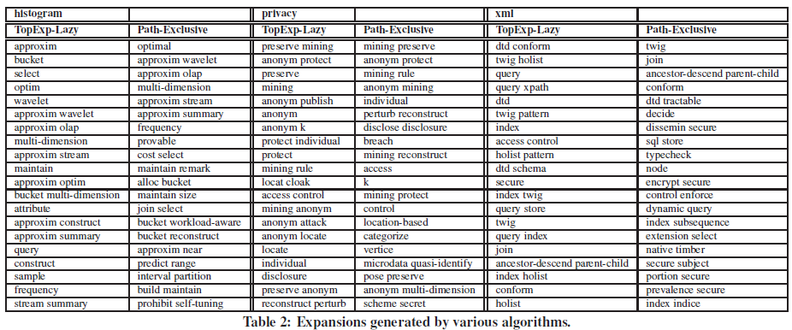

Slide 28
Conclusion
They studied the problem of how to better present search/query results to users.
Proposed various efficient algorithms which can calculate top-k expansions.
Not only demonstrated the performance of the proposed algorithms, also validated the quality of the expansions returned by doing a study on a real data set.

